Slide 1
Sustaining progress in a resource-constrained environment
Martin Gustafsson
Department of Basic Education/Stellenbosch University
January 2026

Slide 2
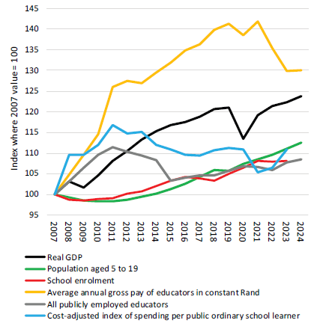
Shape and size of the financing crisis
Cost-adjusted per learner spending roughly stable
Educator numbers largely stable, but…
Educator cost, initial large gains partly lost post-2021
Population-driven demand up by 13% (this was unexpected)
Key resourcing trends since 2007
From Action Plan to 2029
Notes:
Be careful of more recent figures as pre-audited. According to EFW of World Bank, interest payments rising fastr than education spending is a general trend!

Slide 3
Shape and size of the financing crisis (contd.)
Grades 1 to 12 | Compensation of employees. Some growth in educator numbers since 2017, but today essentially like 2012. 2012-2024 enrolments grew 8%. LE ratio stabilised post-2015 only due to 5% reduction in purchasing power of educators (mainly below-inflation adjustments, but also demographics and management depletion).
 | Non-personnel recurrent spending. 2017-2025 real decline in per learner spending 3% for secondary, 8% for primary. Also at primary level, national workbooks initiative saw 12% decline.
 | Payments for capital assets. Massive cuts, 2027 will be 37% lower than 2017.
Grade R. 1% decline 2025 to 2027, despite BELA.
Early learning programmes. 20% growth in conditional grant 2025-2027, but planned growth in funded recipients 120% 2025-2029.
Notes:
This pattern of an overall real decline in per spending but increases in pre-school also seen in Brazil. We are not alone.

Slide 4
Basic education
The larger economic picture
Post-school education
Fact 1. The quality of basic education has improved exceptionally rapidly in South Africa post-2000. We are now on a par with e.g. Brazil.
Fact 2. The global evidence is very clear that qualitative improvements in schooling accelerate social and economic progress.
Fact 3. Our GDP per capita has declined since 2014, youth unemployment is up.
What’s going on?
NDP (in 2012): “skills shortages continue to choke the South African economy”
Youth unemployment
Policy areas
Industrial
Labour
Trade
Fact 4. All youth South Africans get to see the inside of a school, only 40% get into a post-school institution. Basic education thus still accounts for over half of the young labour force.
Notes:
GDP per capita trend from WDI. More youth unemployment means not just hardship for the unemployed, it also means fewer taxpayers able to fund education. What can we do in basic education? Little evidence-driven policy advice here! My sense… More engagement with e.g. employers (including government) and TVET,

Slide 5
Three areas of action
We cannot create money, but we can…
Model future service delivery practices, while keeping in mind changes in demand.
Monitor whether we are spreading the pain equitably, especially by province and quintile.
Engage in the ‘big picture’ spending debates, which influence basic education budgets.
Notes:
Example of where this would have helped: rise in enrolments starting 2011.

Slide 6
Three areas of action (contd.)
A. Policy-focussed modelling of the future
Better evidence may support revisions to our grade repetition policies. But complex! We can’t just slam on the brakes.
Better analysis of trade-offs across levels, especially primary vs secondary, and pre-school vs Foundation Phase, could help us manage e.g. pre-school HR and post provisioning better. All this must be focussed on optimising learning outcomes.
Notes:
The grade repetition analysis should include strategic behaviour by school principals. Class size is important.

Slide 7
Three areas of action (contd.)
B. Equity across provinces and quintiles
Better analysis of the equity of spending could (a) help to ‘tweak’ existing systems, and (b) enable a clearer, less politicised debate on more fundamental change – on the latter, we are by no means the most pro-poor spender in the world.
The provincial equitable share system receives considerable attention, but arguably not in the area that counts most: misalignments between enrolment and population numbers.
Notes:
NETC. Example 1% loss in quintile 5 nationally if curriculum weightings removed (but 7% in EC). On equitable share, MP unduly lost 10% of its entitlements in just 6 years.

Slide 8



Three areas of action (contd.)
C. Big picture spending debates
There is some analysis to draw from, but it could be deeper and more policy-focussed…
Nothing stops us in basic education from working more with DHET, DSD, DoH, SAPS and others on integrated and cost-sensitive strategies on child and youth development (and monitoring of existing strategies!).
Notes:
NETC. Example 1% loss in quintile 5 nationally if curriculum weightings removed (but 7% in EC). On equitable share, MP unduly lost 10% of its entitlements in just 6 years.

Slide 9
Sources
Clayton, R. (2025). Policy brief: The impact of early grade repetition on learner marks. Stellenbosch: RESEP.
Department of Basic Education (2024). Review of progress in the basic education sector to 2024: Analysis of key statistics. Pretoria.
Department of Basic Education (2025). Action Plan to 2029: Towards the realisation of Schooling 2030. Pretoria.
Gustafsson, M. (2023). Trends and targets with respect to NSC results permitting entry into mathematically-oriented programmes at a university. Pretoria: Department of Basic Education.
Gustafsson, M. & Nonkenge, K. (2025). Basic education policy: From 1994 to now. Cape Town: Economic Research Southern Africa.
Hanushek, E.A. & Woessmann, L. (2008). The role of cognitive skills in economic development. Journal of Economic Literature, 46(3): 607-668.
Khuluvhe, N., Bhorat, H., Oosthuizen, M., Asmal, Z. et al (2022). Skills supply and demand in South Africa. Pretoria: Department of Higher Education and Training.
Lustig, N. (2016). Inequality and fiscal redistribution in middle income countries: Brazil, Chile, Colombia, Indonesia, Mexico, Peru and South Africa. Journal of Globalization and Development, 7(1): 17-60.
Van der Berg, S., Gustafsson, M. & Malindi, K. (2020). Education and skills for the economy and links to labour markets in South Africa. Pretoria: National Planning Commission.
World Bank (2024). Education Finance Watch 2024. Washington.

